Slide 1
Team Infinity (AICB1-AI06)
Indian Sign Language Recognition

Slide 2
PROJECT TITLE
In our project we built a Recognition system to predict Indian Sign Language (ISL)
Our Project is titled as ‘Indian Sign Language Recognition’
9/26/2022 Annual Review

Slide 3
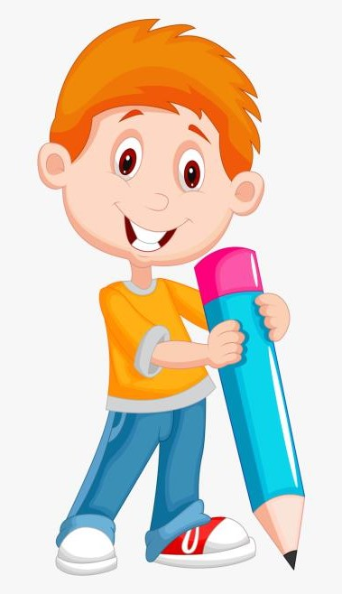

AGENDA
Problem Statement
Project Overview
Who are the end users
Your solution and its value proposition
The wow in your solution
Modeling
Results
Meet our Team
9/26/2022 Annual Review

Slide 4

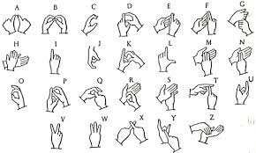
PROBLEM STATEMENT
Dumb and Deaf people use sign language to communicate, which makes normal people difficult to understand them.
We built a Indian sign Language Recognition system which helps normal people to make healthier communication
9/26/2022 Annual Review

Slide 5
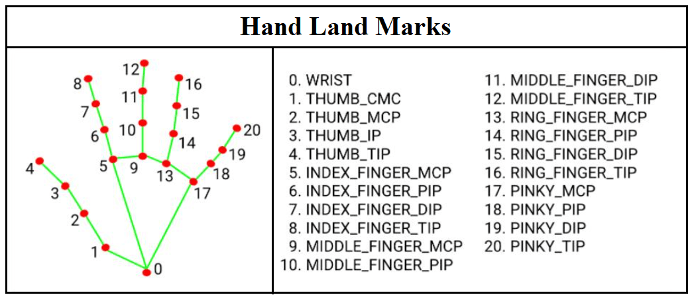
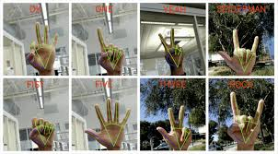
PROJECT OVERVIEW
The dataset used is created based on ISL Dictionary.
We are utilizing MediaPipe , a Framework which is helpful in human face detections.\
After detecting the hand ,key points are extracted and collected
The data is trained by LSTM neural network algorithm and real time testing is done
9/26/2022 Annual Review

Slide 6

WHO ARE THE END USERS?
Schools and Institutes that train such differently-abled people
Deaf and Dumb people
9/26/2022 Annual Review

Slide 7
YOUR SOLUTION AND ITS VALUE PROPOSITION
Our project aims to solve the following problems,
Reduces the bridge between the Normal people and Deaf &Dumb people.
Helps Normal people to have healthier communication with Deaf &Dumb people.
Develops an interest in the Indian community to learn Indian Sign Language.
Helps the Deaf & Dumb community to excel in their Academics
Inspires the Indian citizens to create more ISL Learning websites,Application
Helps Deaf & Deaf community to achieve greater heights in their Dream,Passion, and Career
9/26/2022 Annual Review

Slide 8
THE WOW IN YOUR SOLUTION
In our world there are more than 300 different sign languages like British Sign Language (BSL),American Sign Language(ASL),India Sign Language(ISL) etc. In our project, we are going to use the Indian sign languages (ISL) dataset. Our dataset consists of ISL Alphabets, and ISL Number.
There have been many projects implemented on Sign Languages recognition. Some projects have been built around the principle of Frame at a point.The approach we are going to use is to take more frames and predict the action and translate them from ISL to English Languages. This can be done using the MediaPipe framework.
9/26/2022 Annual Review
8

Slide 9
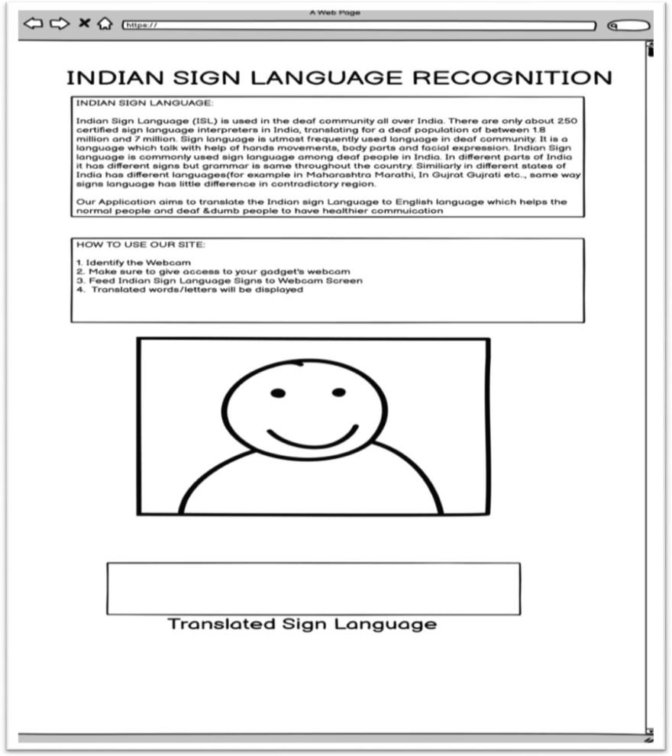
MODELLING
Our Future works is to built Web Application using Streamlit/Gradio.A Open source app framework in python language to build a Website.
WIREFRAME
9

Slide 10
RESULTS
By using LSTM Model we achieved Categorical accuracy ranging between 95 % to 100%
Demo Link
9/26/2022 Annual Review
10

Slide 11
Our Team Members
Hari Lakshmi A.S
Anushka Bajirao Patil
Mekapothu Manikanta Reddy
Pavaneswar Akula
Sikandar Bash
Vrushali Arun Ghuge

